Slide 1
Mini Supermarket Management System
Class Name: PF08 Group Name: Group 04
Member: Nguyễn Quyết Thắng
Trần Văn Huân
Nguyễn Vũ Huân

Slide 2
Objectives
1.Providing management software that ensures a high level of accuracy and security
2 Strictly manage products and orders
3 Execute quickly and accurately the requests that users give to the system

Slide 3
Customer Requirements
Login
Create Order
Update Order
Insert Product
Update Product

Slide 4
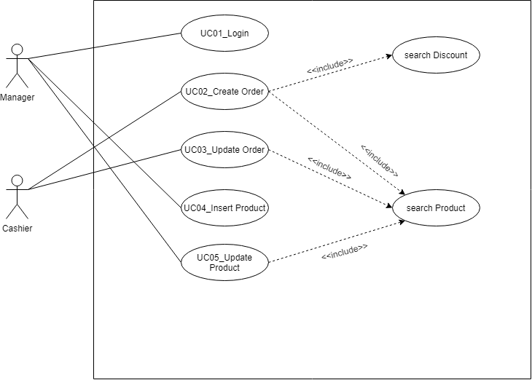
Use Case

Slide 5
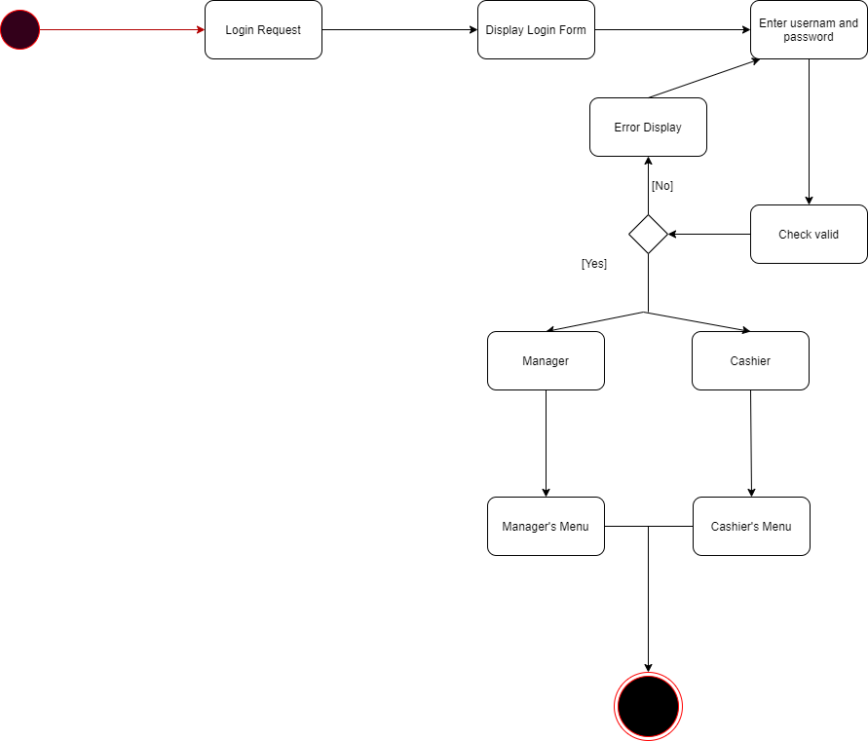
Activity Diagram
1.Login

Slide 6
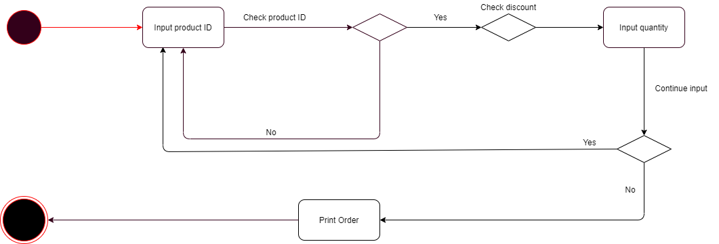
Activity Diagram
2.Create order

Slide 7
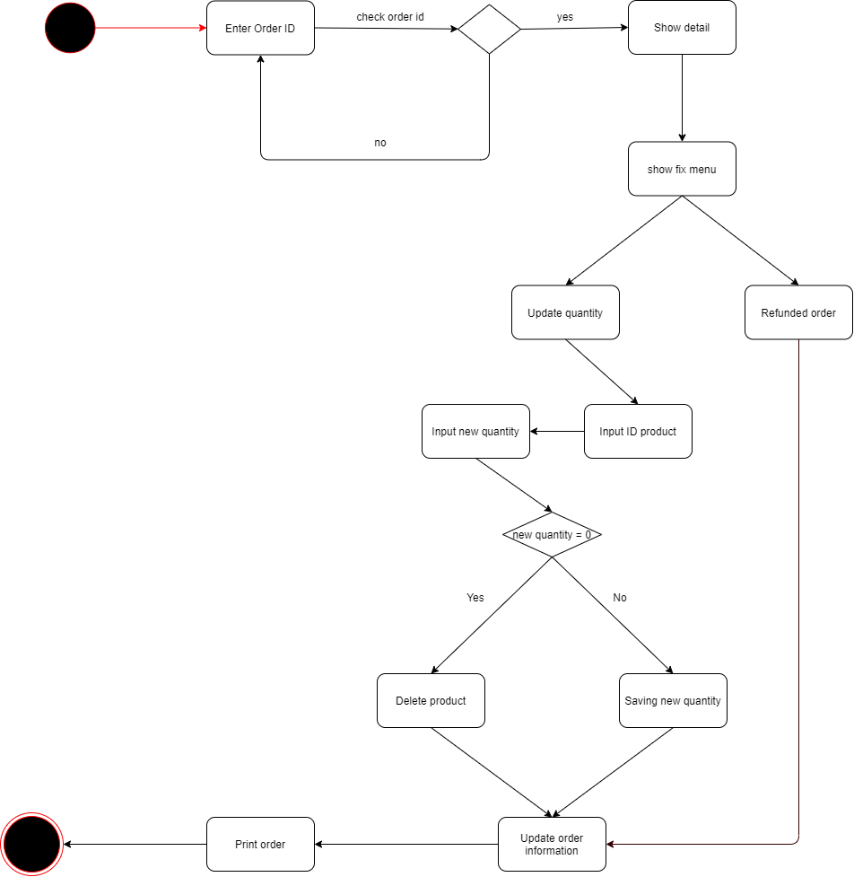
Activity Diagram
3.Update order

Slide 8
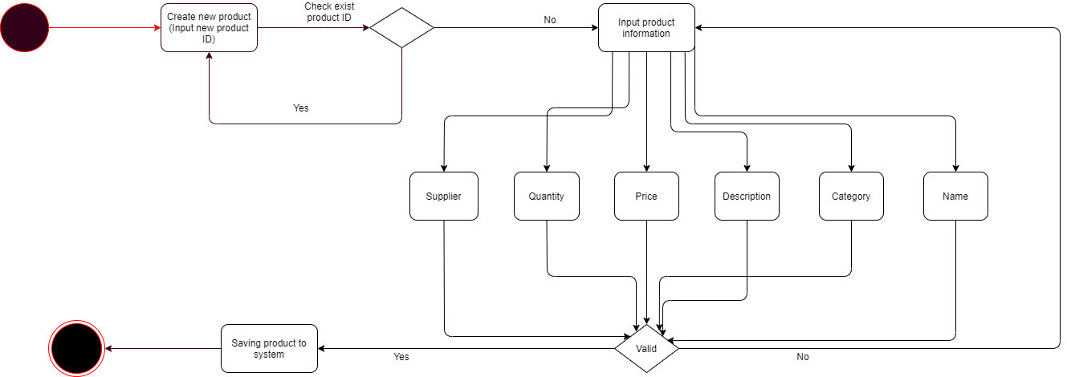
Activity Diagram
4.Insert product

Slide 9
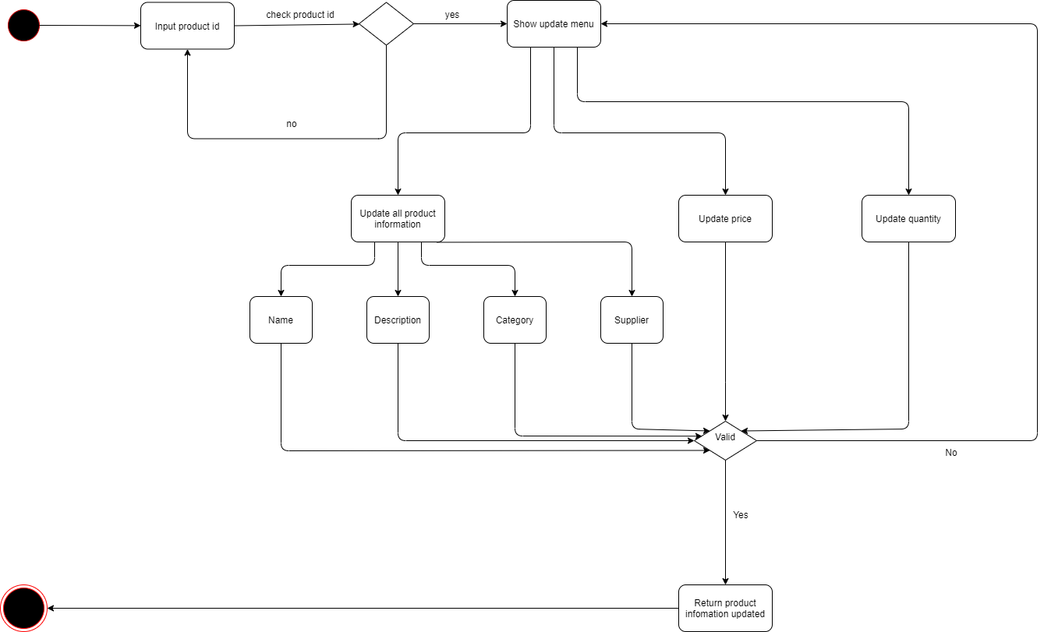
Activity Diagram
5.Input product

Slide 10
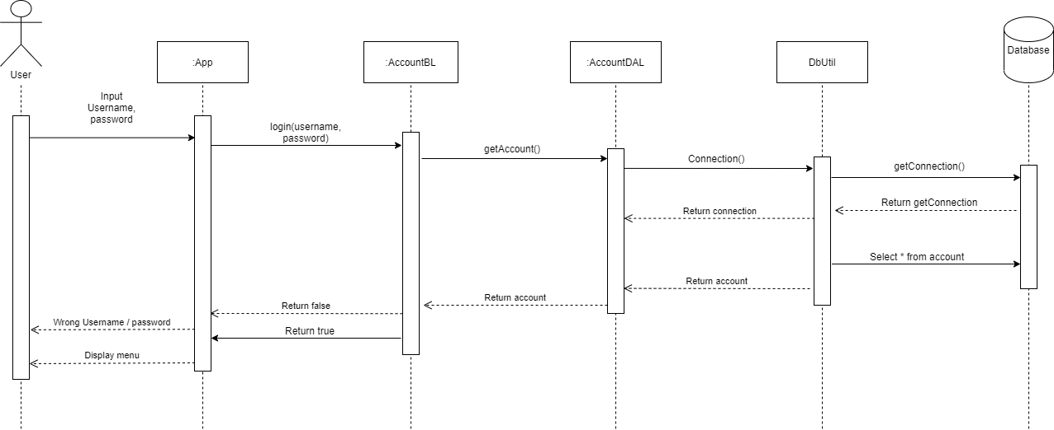
Sequence Diagram
1.Login

Slide 11
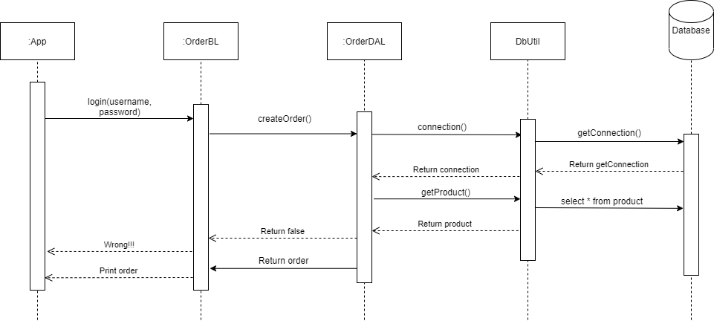
Sequence Diagram
2.Create order

Slide 12
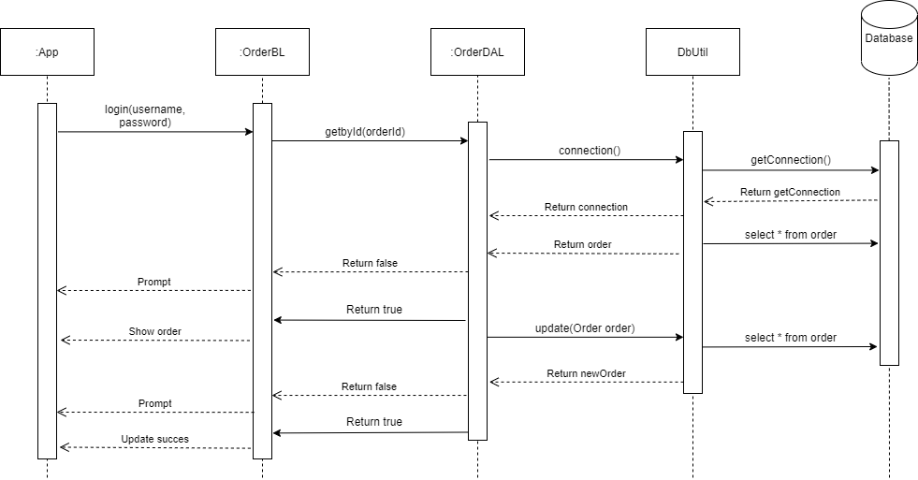
Sequence Diagram
3.Update order

Slide 13
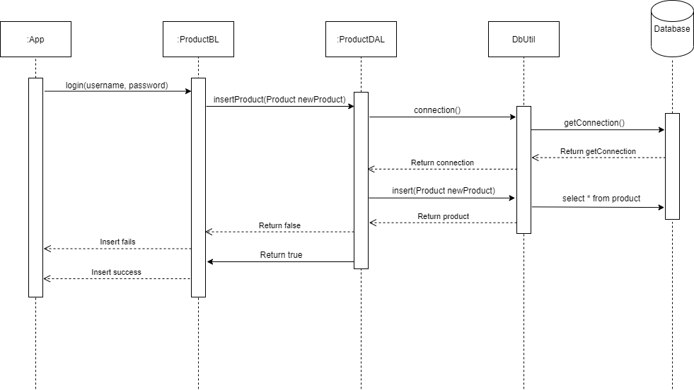
Sequence Diagram
4.Insert product

Slide 14
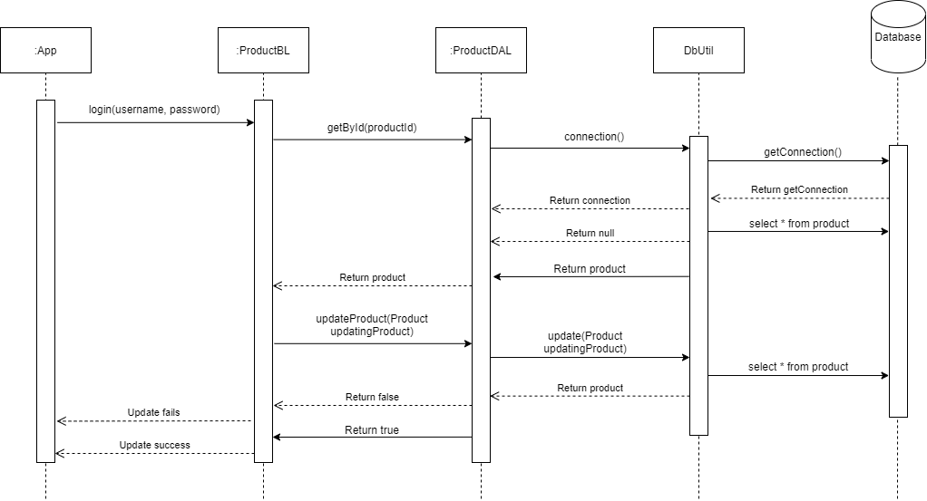
Sequence Diagram
5.Update product

Slide 15
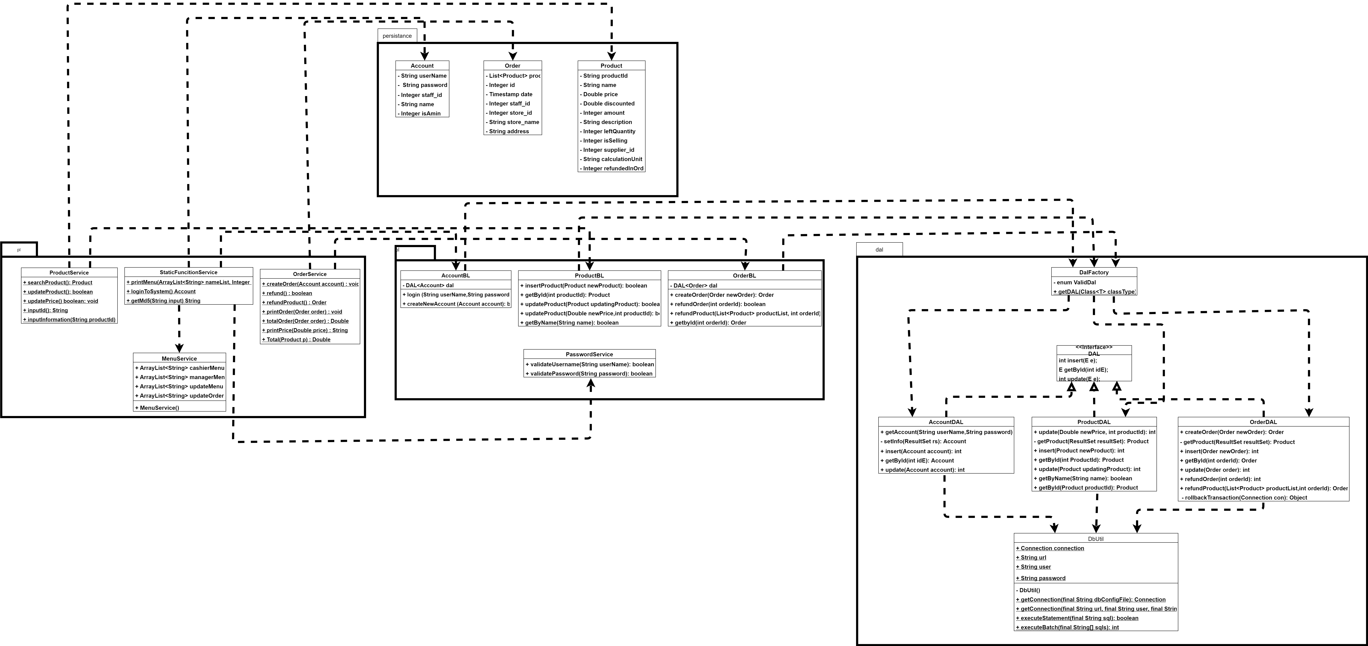
Class Diagram

Slide 16
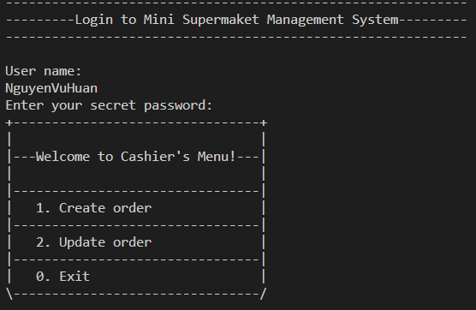
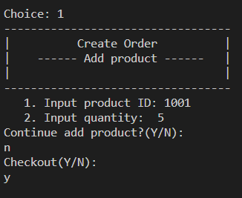
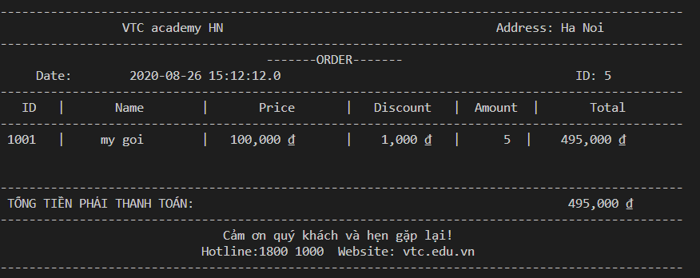
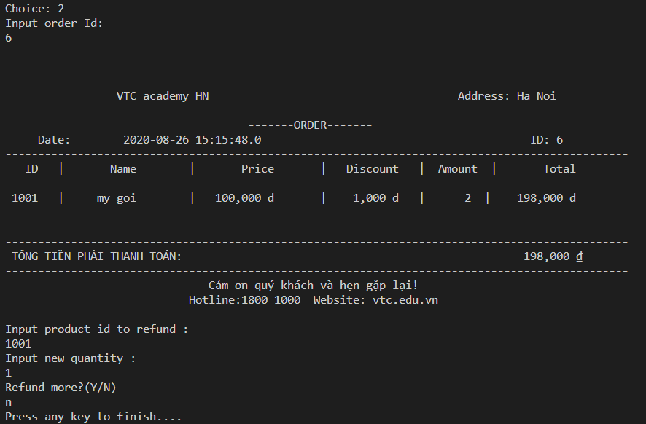
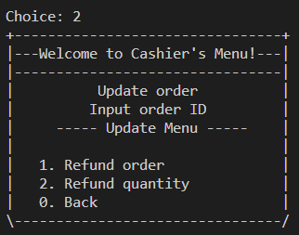
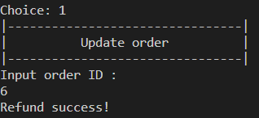
UI Design
Cashier Menu

Slide 17
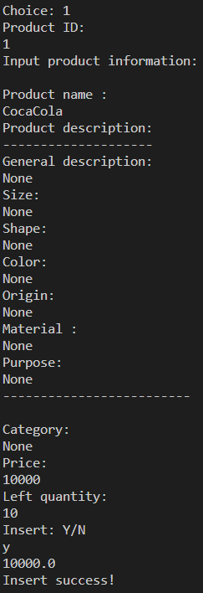
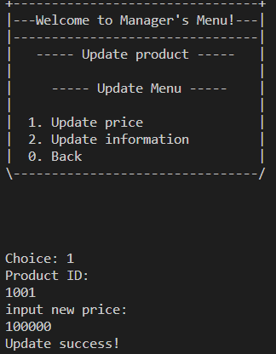
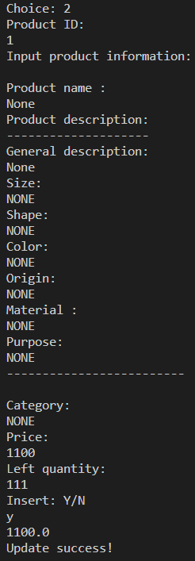
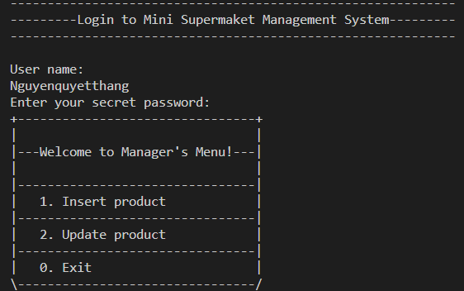
UI Design
Manager Menu

Slide 18
Assign work to each team member
Group 4 | Minisupermarker MS
No | Task name | Description | Start Date | End Date | Member | Self assessment
1 | System design | System model architecture | 24/07/2020 |  | Nguyễn Quyết Thắng
2 | Use case design | Design system features | 30/07/2020 |  | Nguyễn Quyết Thắng, Trần Văn Huân, Nguyễn Vũ Huân
3 | Entity relationships design | Identify the entities in the system and the relationships between them | 28/07/2020 | 29/07/2020 | Trần Văn Huân Nguyễn Quyết Thắng

Slide 19
Assign work to each team member
Group 4 | Minisupermarker MS
No | Task name | Description | Start Date | End Date | Member | Self assessment
4 | Entity relationships design details | Construct tables that represent properties of entities and the relationship between entities | 28/07/2020 | 29/07/2020 | Trần Văn Huân Nguyễn Quyết Thắng
5 | Design database | Database building | 30/07/2020 | 06/08/2020 | Nguyễn Quyết Thắng
6 | Use case description | Describe in detail the use case | 01/08/2020 | 06/08/2020 | Nguyễn Quyết Thắng Trần Văn Huân Nguyễn Vũ Huân

Slide 20
Assign work to each team member
Group 4 | Minisupermarker MS
No | Task name | Description | Start Date | End Date | Member | Self assessment
7 | Design activity diagram for each use case | Design the system's task processing flowchart for each use case | 01/08/2020 | 07/08/2020 | Nguyễn Vũ Huân Trần Văn Huân Nguyễn Quyết Thắng
8 | Design sequence diagram for each use case | Design sequence diagrams for the system's workflow for each use case | 01/08/2020 | 25/08/2020 | Trần Văn Huân Nguyễn Vũ Huân Nguyễn Quyết Thắng
9 | Class diagram for system | Designing detailed drawing class for the system | 03/08/2020 | 20/08/2020 | Trần Văn Huân Nguyễn Vũ Huân Nguyễn Quyết Thắng

Slide 21
Assign work to each team member
Group 4 | Minisupermarker MS
No | Task name | Description | Start Date | End Date | Member | Self assessment
10 | Coding | Write code based on class diagrams | 15/08/2020 | 26/8/2020 | Nguyễn Quyết Thắng Trần Văn Huân Nguyễn Vũ Huân
11 | Bug fixes, optimizations upgrades for the code | Fix errors, optimize code, upgrade system features | 15/8/2020 | 25/08/2020 | Nguyễn Quyết Thắng
12 | Deployment diagram | Drawing up the project environment | 01/08/2020 | 26/08/2020 | Nguyễn Quyết Thắng Trần Văn Huân Nguyễn Vũ Huân

Slide 22
Assign work to each team member
Group 4 | Minisupermarker MS
No | Task name | Description | Start Date | End Date | Member | Self assessment
13 | Attach report | Report writing | 07/08/2020 | 26/08/2020 | Nguyễn Quyết Thắng Trần Văn Huân Nguyễn Vũ Huân
14 | Wriet slides | Presentation material | 26/08/2020 | 26/08/2020 | Nguyễn Vũ Huân Trần Văn Huân Nguyễn Quyết Thắng

Slide 23
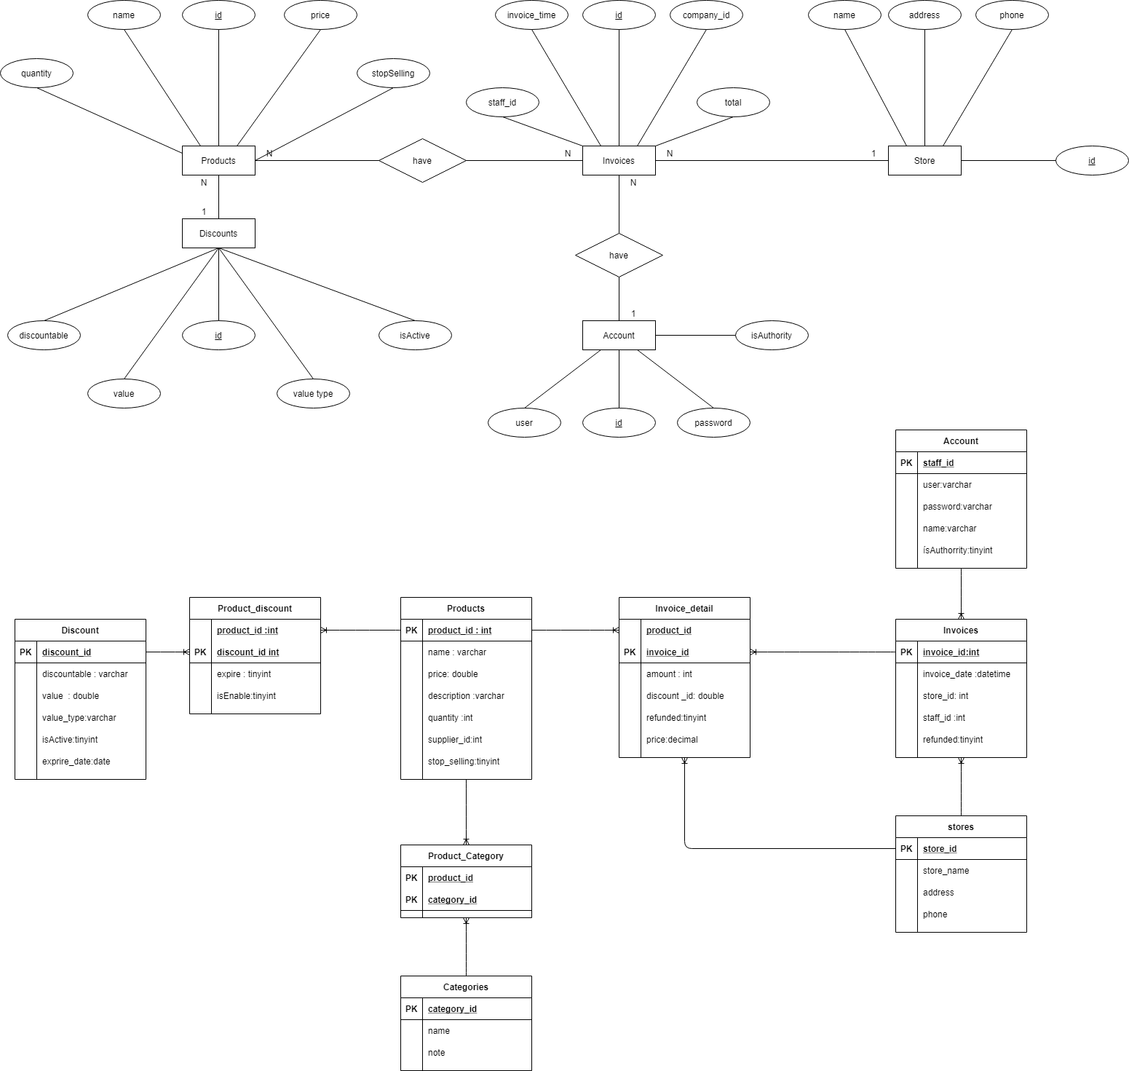
Entity Relationship Diagram

Slide 24
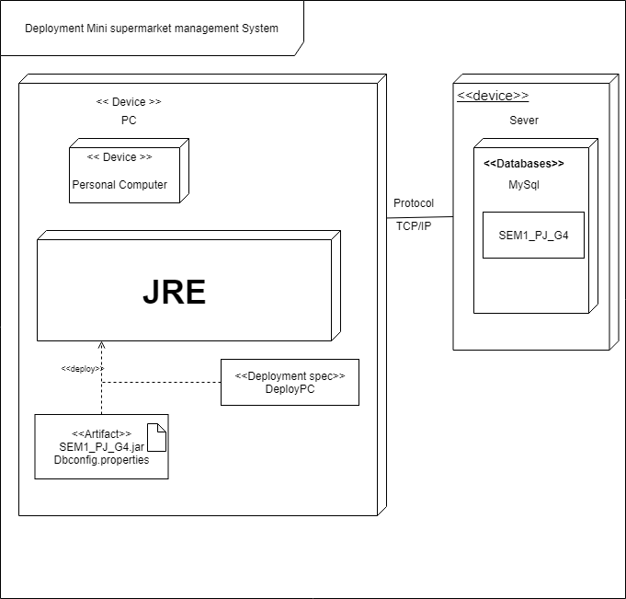
Deployment Diagram

Slide 25


Slide 26
Q & A

